Slide 1
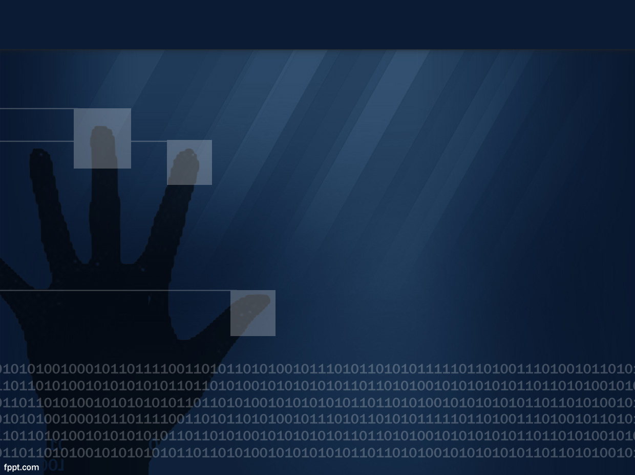
INFORMATION AND SYSTEM SECURITY project

Slide 2
ABSTRACT
Submitted to :
Faculty:Prof.Rajesh Kumar
Slot : D1.

Slide 3
IMAGE Stenographer

Slide 4
Team :
+ Chandra Movule(12mse1158)
+ Karthick(12mse1159)
+Gokulnath (12mse1141)

Slide 5
What are we going to do ?
Develop a high security software which hides the secret message into an image
And reads the hidden message from an image(decoder).
Provides high security for the encrypted message.

Slide 6
Expected features :
High security to the message.
Capable to store long messages.
No noticeable changes in encrypted image from original image.
(if viewed through naked eye.)
Simple and User friendly interface.
Works for any formatted image.

Slide 7
So, how are we going to do it ?
The basic idea of our program is to utilize the 4th proprty of thr image other than the r,g,b ,. That is alpha (a) pixels of the image to store the data.
We are following pixel level organisation of ARGB system.

Slide 8
We will use least significant bit of Alpha part of the pixel to store the message.
Hence for low quality images , more bits would be used tostore the data.
Hence rgb wont be changed hence we cant notice any changes in image through naked eye.

Slide 9
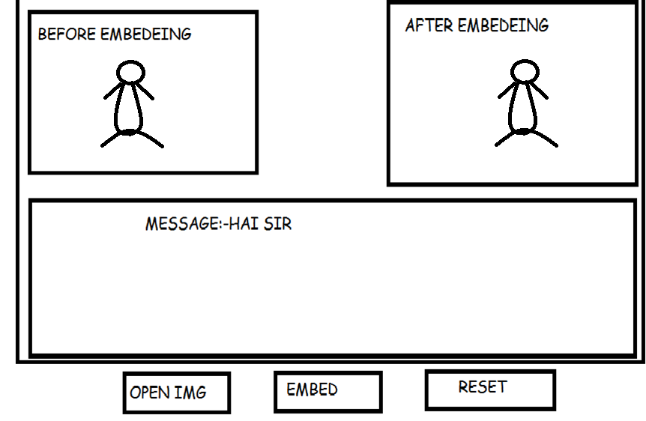
Expected interface :
Quality software.

Slide 10
Interface development :
The interface design would be made user friendly, and graphic functions may be used and some internet home work would be done to develop it.

Slide 11
Thank you

